Slide 1

Forensic Tools For Computers And Networks
CIS 4370 Security Risk Management Group 1: Vanessa Munoz

Slide 2

Principles of Forensic Tools
Terminology
Digital Forensic
Accuracy of Forensic Tools

Slide 3
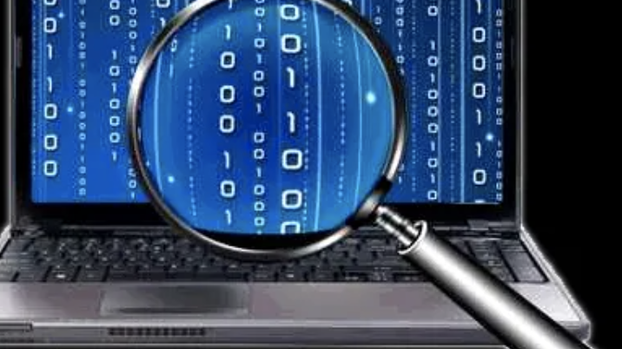
Terminology of Forensic Tools
What does “Computer Forensics” mean?
Computer forensics is a term that refers to the investigation of computers.

Slide 4
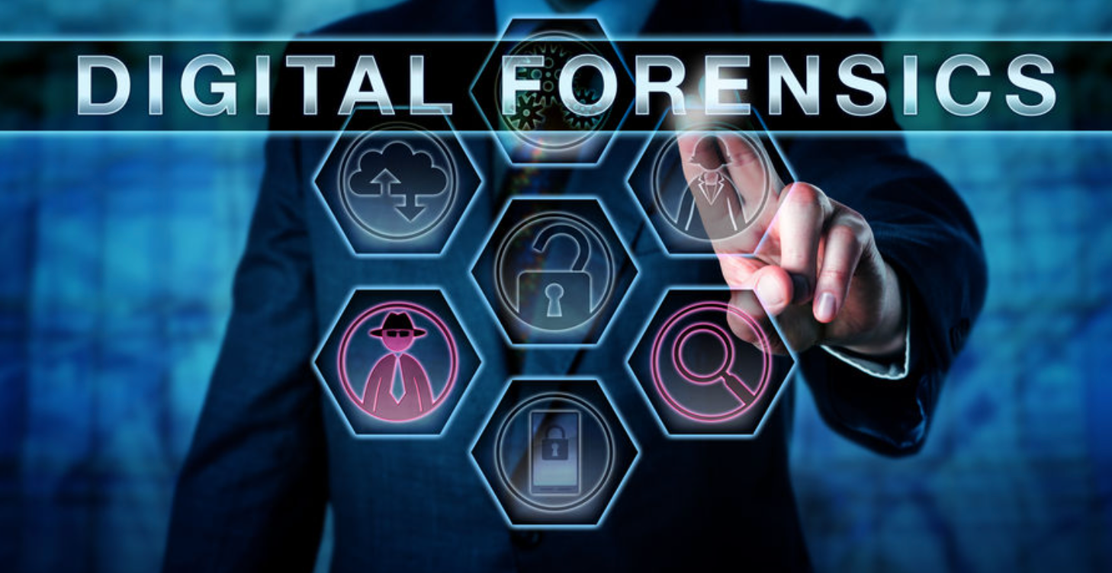
Digital Forensics
Digital forensics covers not only computers, but also digital networks, mobile phones, and usb sticks.
Digital Forensic Types:
Disk Forensics, Network Forensics, Wireless Forensics, Database Forensics, Malware Forensics

Slide 5

Accuracy Of Forensic Tools
Jacob K., Shichun L., Maria C., (2020)
“Public beliefs about the accuracy and importance of forensic evidence in the United States”
From 55% for voice analysis to 83% for DNA analysis
With the majority of procedures falling between 65 and 75% accurate.
However, many researchers still believe that forensic evidence is vital for any criminal case.
Always room for improvement

Slide 6
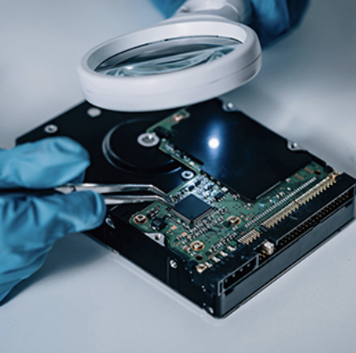
Methodology of Forensic Tools
What is cybercrime?
Can Cybercriminals be blocked?
For Android Phone: Autopsy, and MOBILedit are helpful applications.
For iOS phones: iBackup Extractor and iPhone Analyzer are also useful.
https://www.livemint.com/technology/tech-news/cybercriminals-turning-smarter-have-resources-to-take-on-large-organisations-11596185293883.html

Slide 7
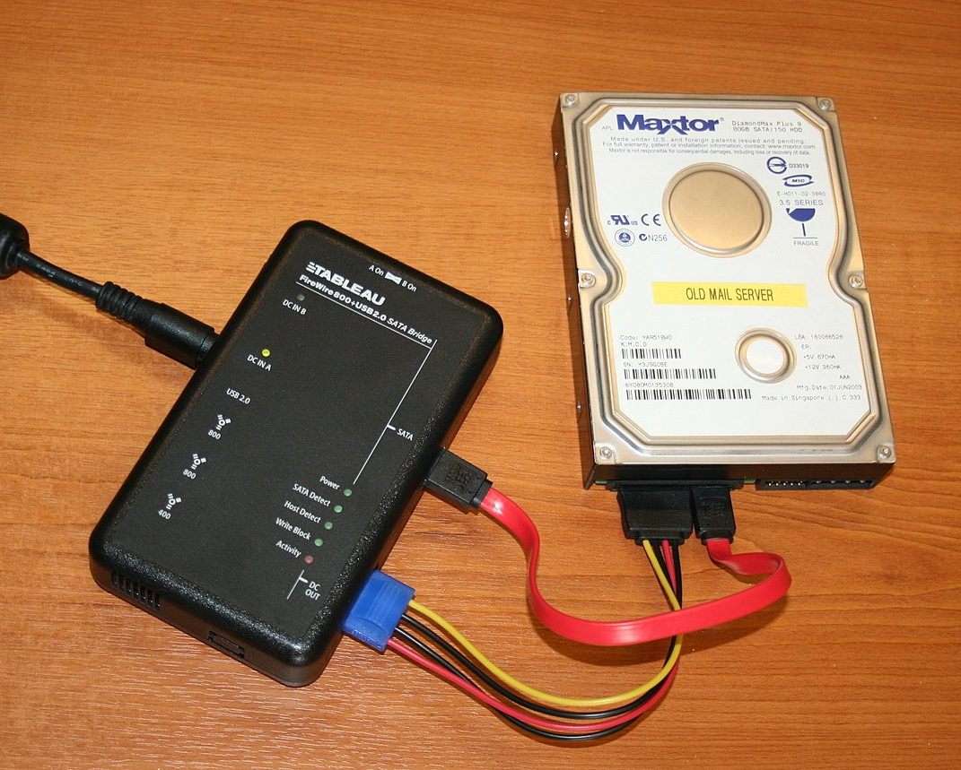
Analysis of Forensic Tools
What forensic tools are used during the forensic process?
How are forensic tools used throughout the forensic process?

Slide 8
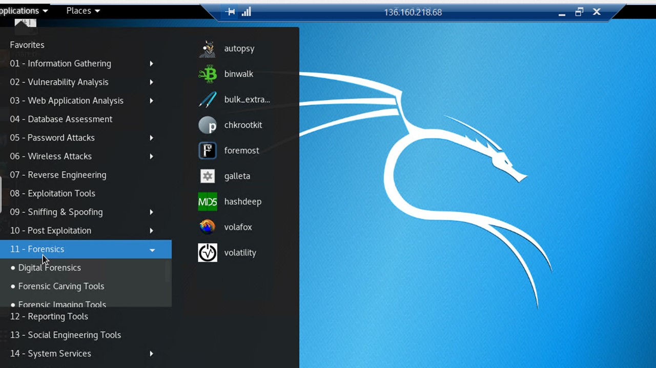
Usability of Forensic tools
Survey in 2021 in India finds:
The right tool is critical for an investigation
Favor command line over graphic user interface.
They wanted more support and feedback for open-source tools

Slide 9

FUTURE of Forensic tools
Increasingly sophisticated attacks require more sophisticated tools
Rise of cloud-based forensic tools
Current tools examined are focused on collecting data rather than performing analysis

Slide 10
Conclusion
There are many different types of forensics tools created for specific tasks in the forensic process
They are extremely important for forensic investigations
Using forensic tools effectively is vital to understanding how attacks occur.
Tools need to be simple to use.
However increasingly sophisticated attacks require more sophisticated tools.
Everyone must constantly adapt to counter cyberattacks, which includes the tools needed to study them.

Slide 11
References
https://techmonitor.ai/what-is/what-is-computer-forensics-4926732
https://blog.malwarebytes.com/security-world/2017/08/explained-digital-forensics/
https://leverageedu.com/blog/cyber-forensic/
https://www.livemint.com/technology/tech-news/cybercriminals-turning-smarter-have-resources-to-take-on-large-organisations-11596185293883.html
https://www.uco.edu/programs/fsi/program-forensic-science-digital-forensics-major
https://www.tripwire.com/state-of-security/security-data-protection/cloud/forensics-cloud-need-to-know/

